Slide 1

Pneumonia Detection
Notes:
This sample serves as a guideline on what should be covered on Go-to-Market / Sustainability Proposal

Slide 2
Intro of our capstone team
Our team proposes to make an application that can classify the x-ray results, whether pneumonia or not. Pneumonia is inflammation of the lungs caused by infection. Some of the symptoms commonly experienced by people with pneumonia are cough with phlegm, fever, and shortness of breath. Pneumonia is the number one killer in the world for toddlers, while in Indonesia pneumonia and diarrhea are the main preventable causes of infant and child mortality. The World Health Organization (WHO) estimates that 15% of deaths in children under the age of 5 are caused by this disease. During this pandemic, the corona virus can also cause pneumonia or an infection that causes inflammation of the lungs. This pneumonia is different from the usual pneumonia that is common.

Slide 3
Backgrounder Facts

Slide 4
Backgrounder
Pneumonia is the first cause of death in infants and toddlers in Indonesia. Based on the 2019 Indonesian Health Profile, it is known that there are more than 400 thousand cases of pneumonia in Indonesia. Source: kemkes.go.id
Corona virus can cause pneumonia or an infection that causes pneumonia. This pneumonia is different from the usual pneumonia that is common. Source: cnnindonesia.com

Slide 5
Intro of our capstone project
We made an application that can classify x-ray results whether pneumonia or not. The dataset we use comes from kaggle.com in the form of COVID-19 X-ray samples taken from various sources due to the unavailability of a large specific data set. The dataset is organized into 3 folders (covid, pneumonia, normal) containing posteroanterior (PA) chest X-ray images. A total of 6939 samples were used in the experiment, of which 2313 samples were used for each case. This image prediction model using a keras.Sequential model, and loads data using preprocessing.image_dataset_from_directory. This model consists of three convolution blocks with a maximum pool layer in each block. There is a fully connected layer with 512 units on it which is activated by the relu activation function.

Slide 6
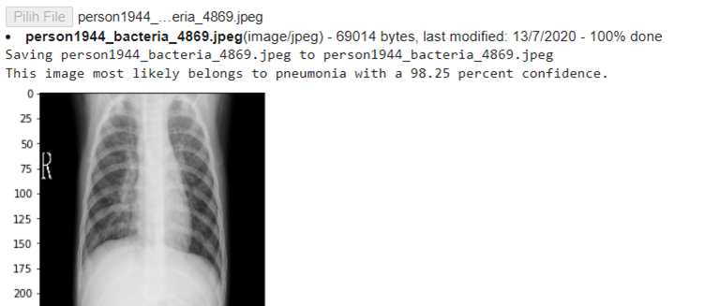
X-ray image prediction screen display

Slide 7
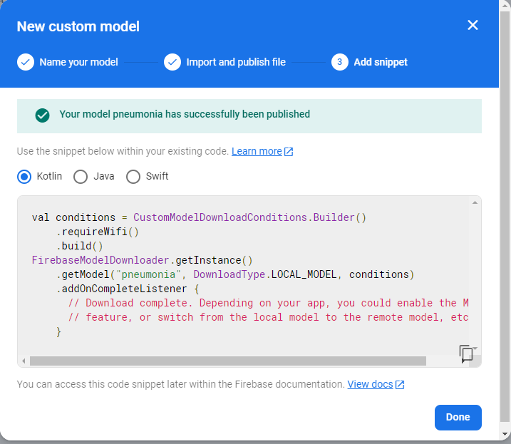

Slide 8

Target Market or Personas
Age range
20 - 50 years old
Profession
Healthcare Industry
Radiologist, Doctor, Nurse, Civil Society, Patient Guardian.
Roles
As a user
Specific Attributes or likings, hobbies
No need a specific attribute

Slide 9
Why our target market needs our solution?
Purpose-driven
To help medical personnel in dealing with pneumonia.
To speed up the diagnosis and produce the appropriate clinical results.
Data-driven
Based on the previous research by Varshni, D et al (2019), pretrained CNN models in analyzing chest X-ray images, specifically to detect Pneumonia have a good accuracy of 70-80 percent.
Government reasoning
The 2018 Basic Health Survey (Riskesdas) shows that the prevalence of pneumonia increased last year to 2 percent from 1.85 percent in 2013. Nationwide, confirmed cases of pneumonia in children under 5 have increased by about 500,000 per year from 2015 to 2018.
Thus, the death rate caused by pneumonia will decrease.
Stakeholders related and benefited from your solutions
If stakeholders support this solution, it is equivalent to them helping to reduce the death rate caused by pneumonia in Indonesia.

Slide 10
Our Roadmap
Business Opportunities
Not many health technology products in Indonesia
Technology Advantages
Application of artificial intelligence technology that is able to provide good analytical results.
Tackling bigger problems in the future
Reaching many users and being able to educate the Indonesian people about the importance of early detection of diseases
Benefits for long-term
Helping medical professionals more quickly in handling patients
Notes:
Aspects of these roadmap categories must be applied

Slide 11
Until now, our team could only model and train machine learning via the cloud. We haven't been able to deploy an Android app.

Slide 12
It’s A Final Progress of Patrick Star’s Capstone Project,
Thank You!

